Slide 1
DIGIHEALTH
Team members
Ankita Ashok Indi
Prasanna Nimbalkar
Rakesh Ramesh baddi
An Automated Healthcare Ecosystem
INFO 5100 Final Project

Slide 2
PROBLEM AND SOLUTION
IS HEALTHCARE EASILY ACCESIBLE BY ALL?
Abridge the gap between government and healthcare institutions for fund disbursal during pandemics
Streamline urban as well as rural healthcare services.
Provide affordable healthcare services.
Less commuting time as health care services will be situated in locality.

Slide 3
This healthcare model is touted to facilitate paperless insurance processing between 3 big players in insurance claims:
Insurance corporation
Insurance Claim
Health Institution
Bridge gap between insurance policies, customers and healthcare center
Streamlines patient’s treatment process.
Can prove to be of crucial use where time is of essence, treating and maintaining patient records is critical

Slide 4
APPLICATION FUNCTIONS
Healthcare Admin can add enterprises
Doctors will examine and treat patients
If patient is not cured in health center, the he/she will be transferred to specialty hospitals
Government department provides funding to enterprises
Insurance Agent approves patient bills
Reimbursement of approved bills from insurance companies

Slide 5
ROLES
Government officer
Insurance Financier
Policy Planner
Patients
Doctors
Admins
Secretary
Accountants
Lab assistants
Insurance Agents
Treasurer

Slide 6
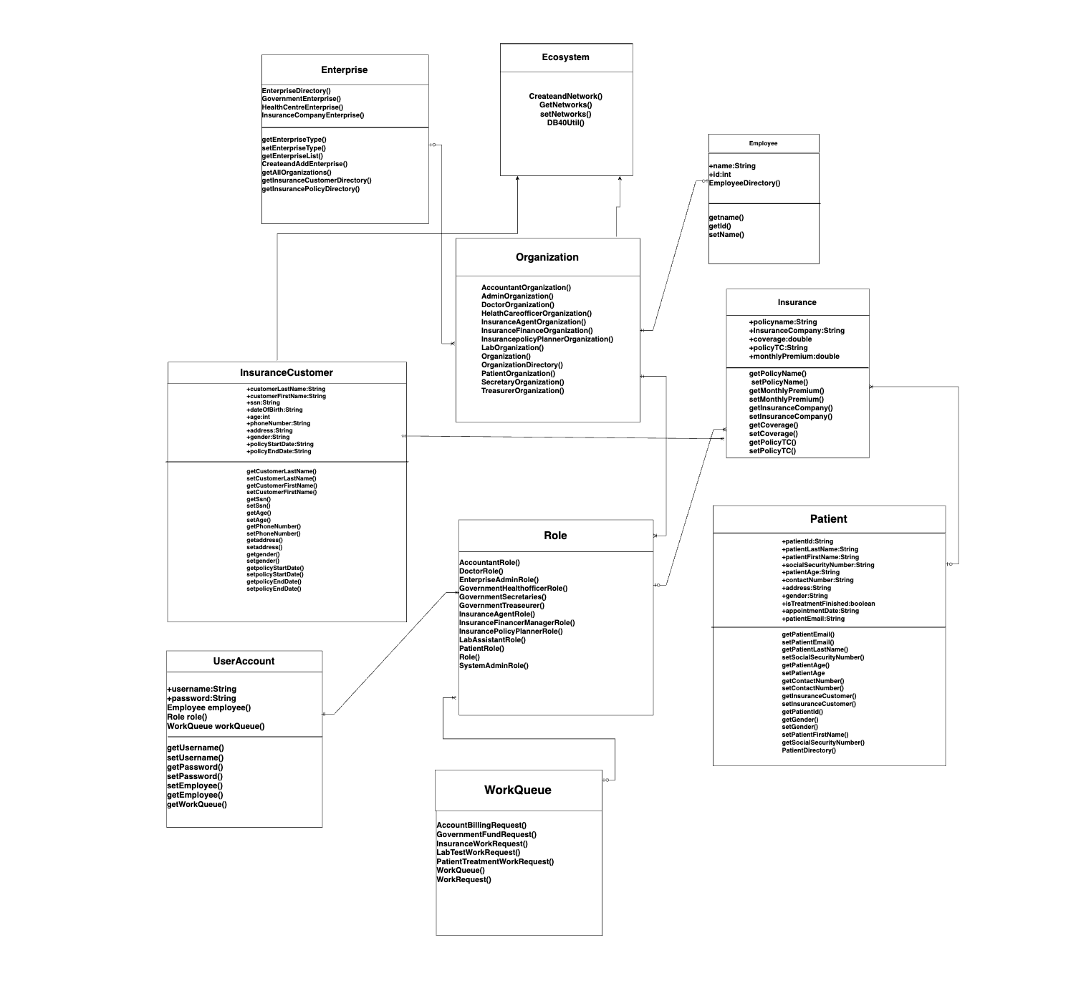
CLASS DIAGRAM

Slide 7
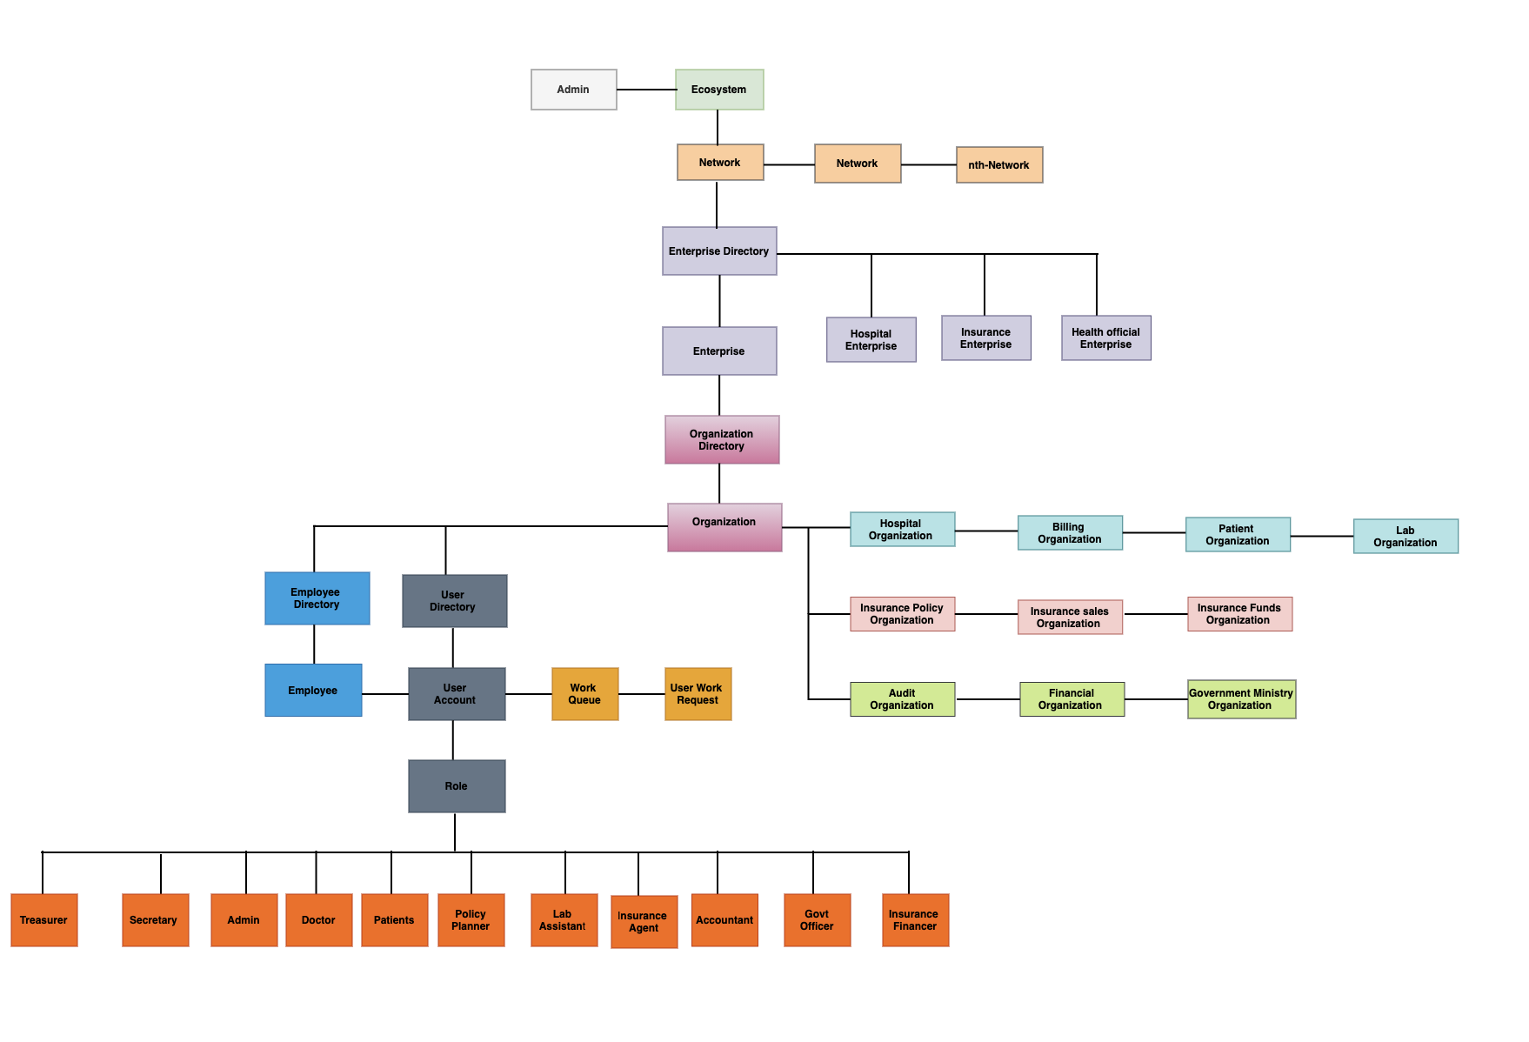
OBJECT DIAGRAM

Slide 8
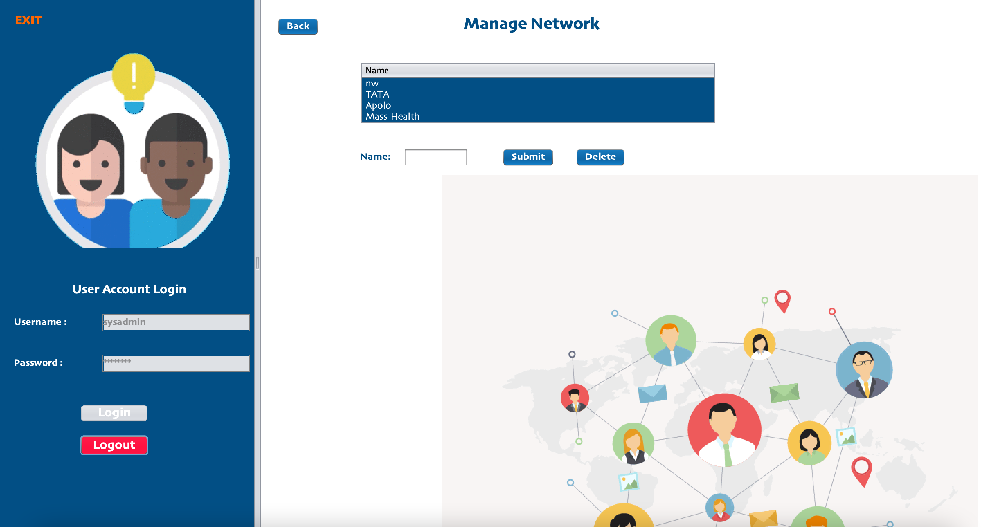

Slide 9
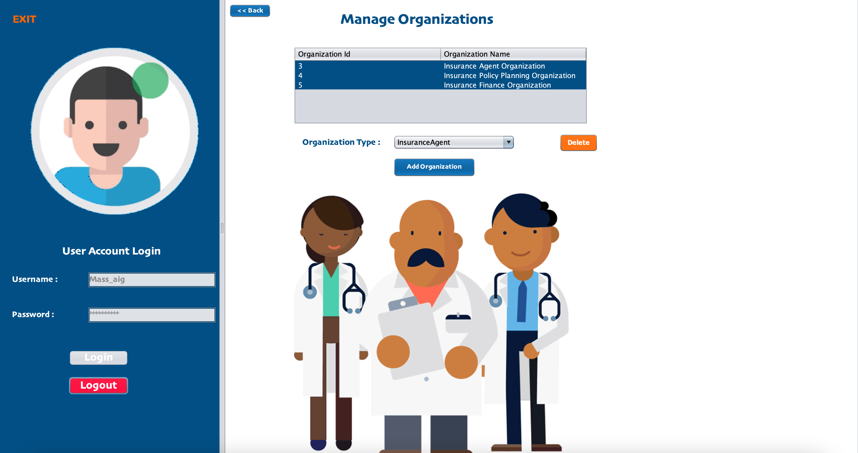

Slide 10
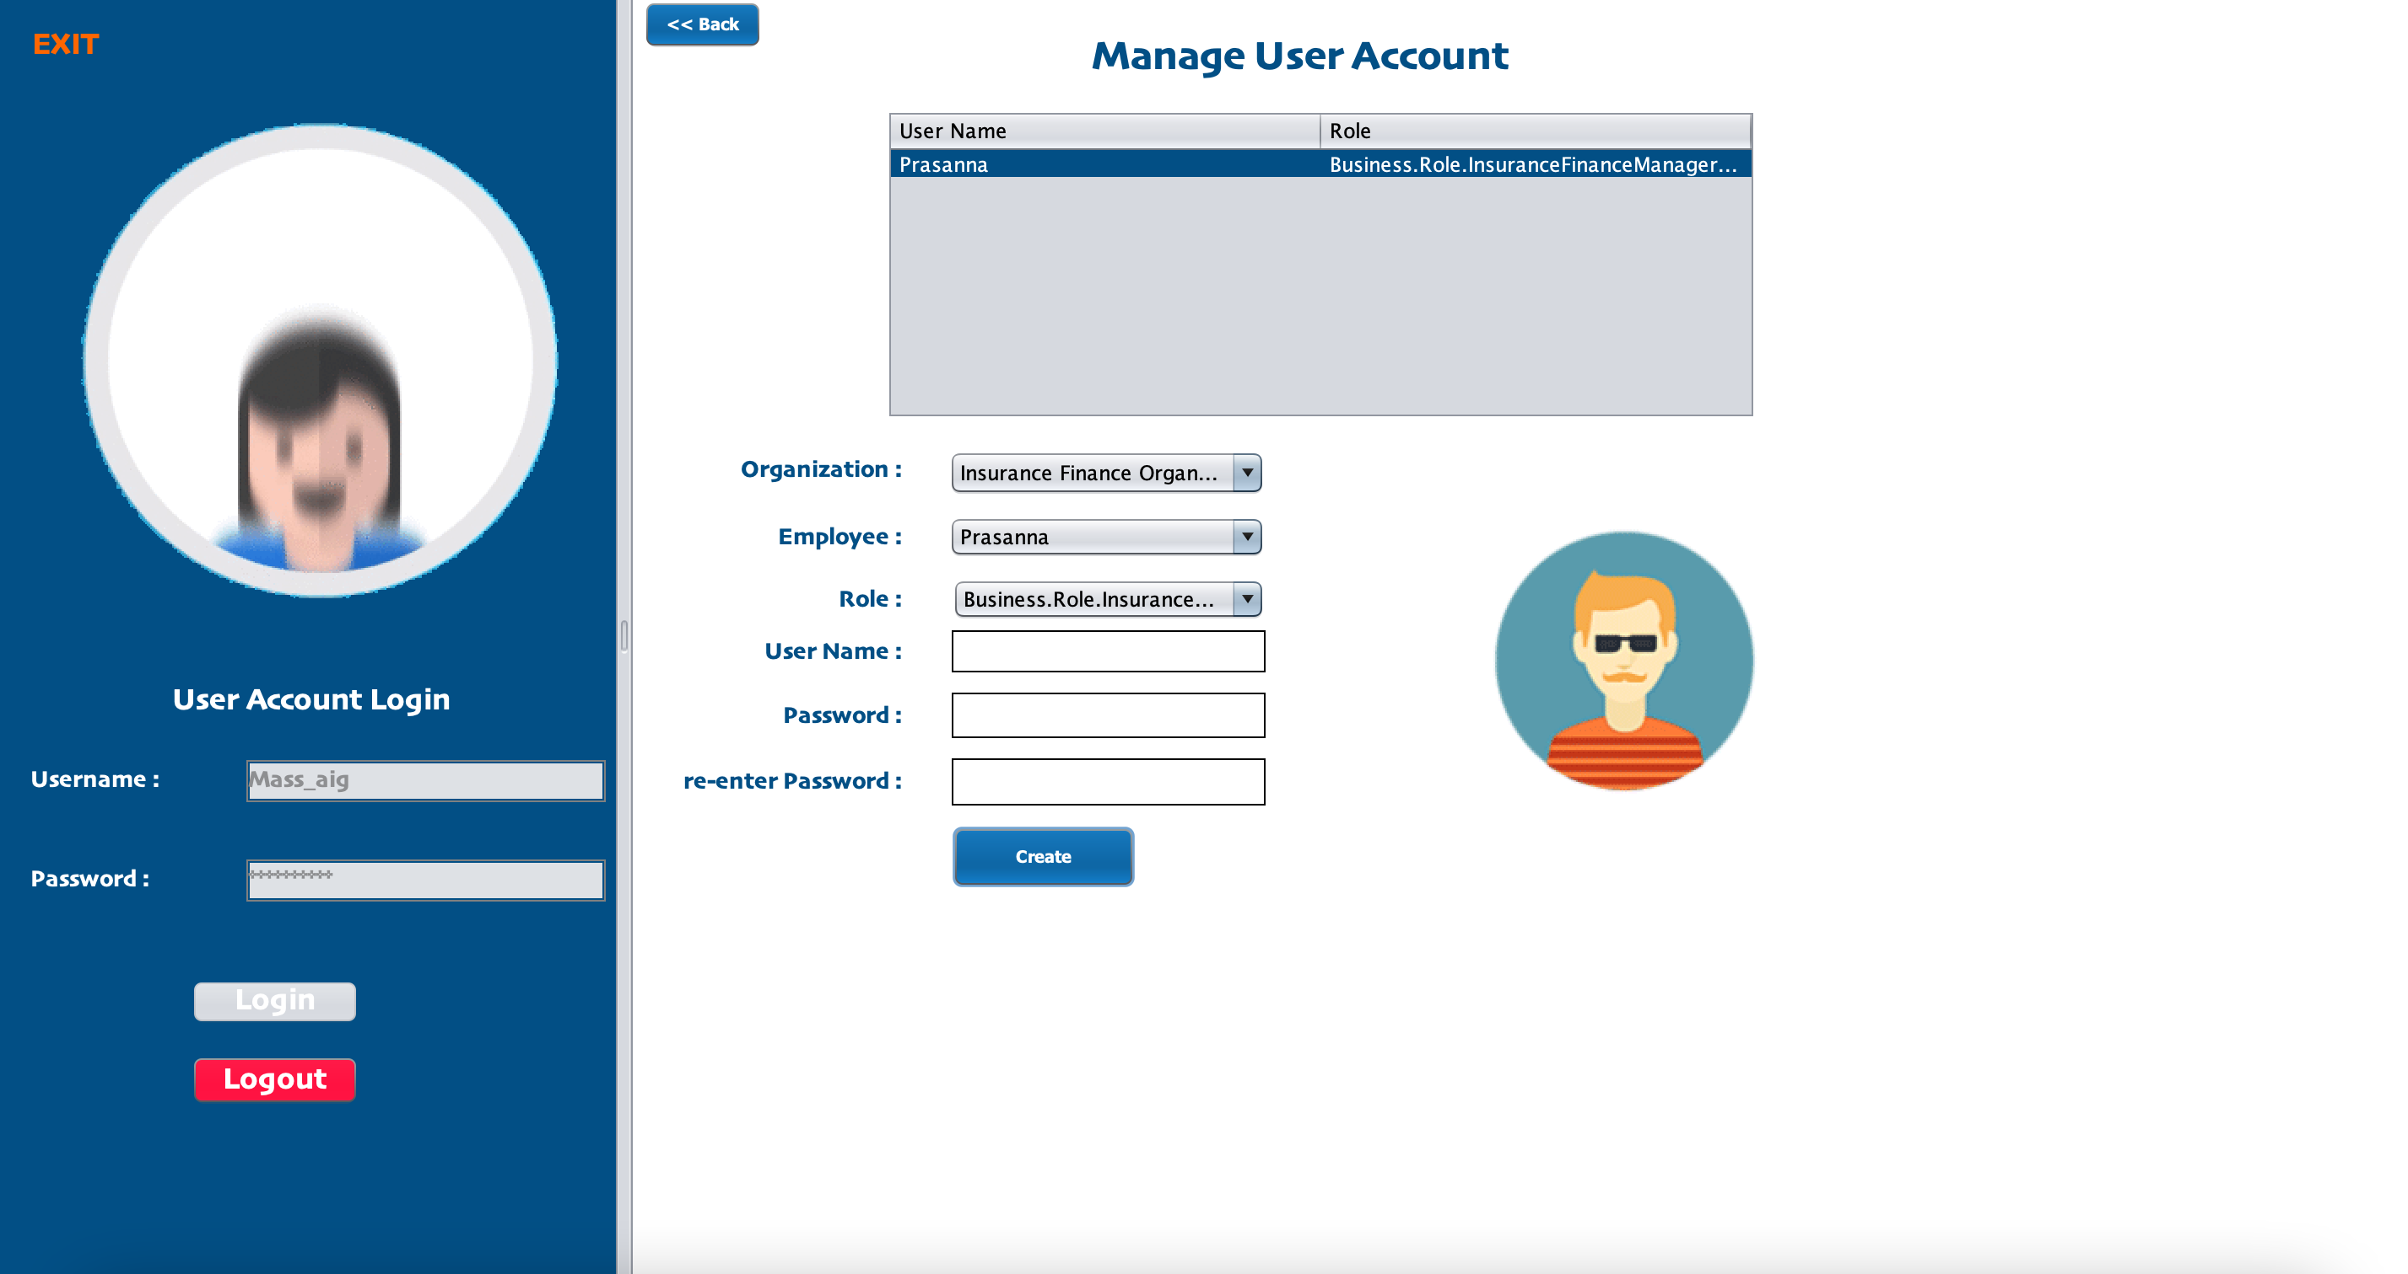

Slide 11
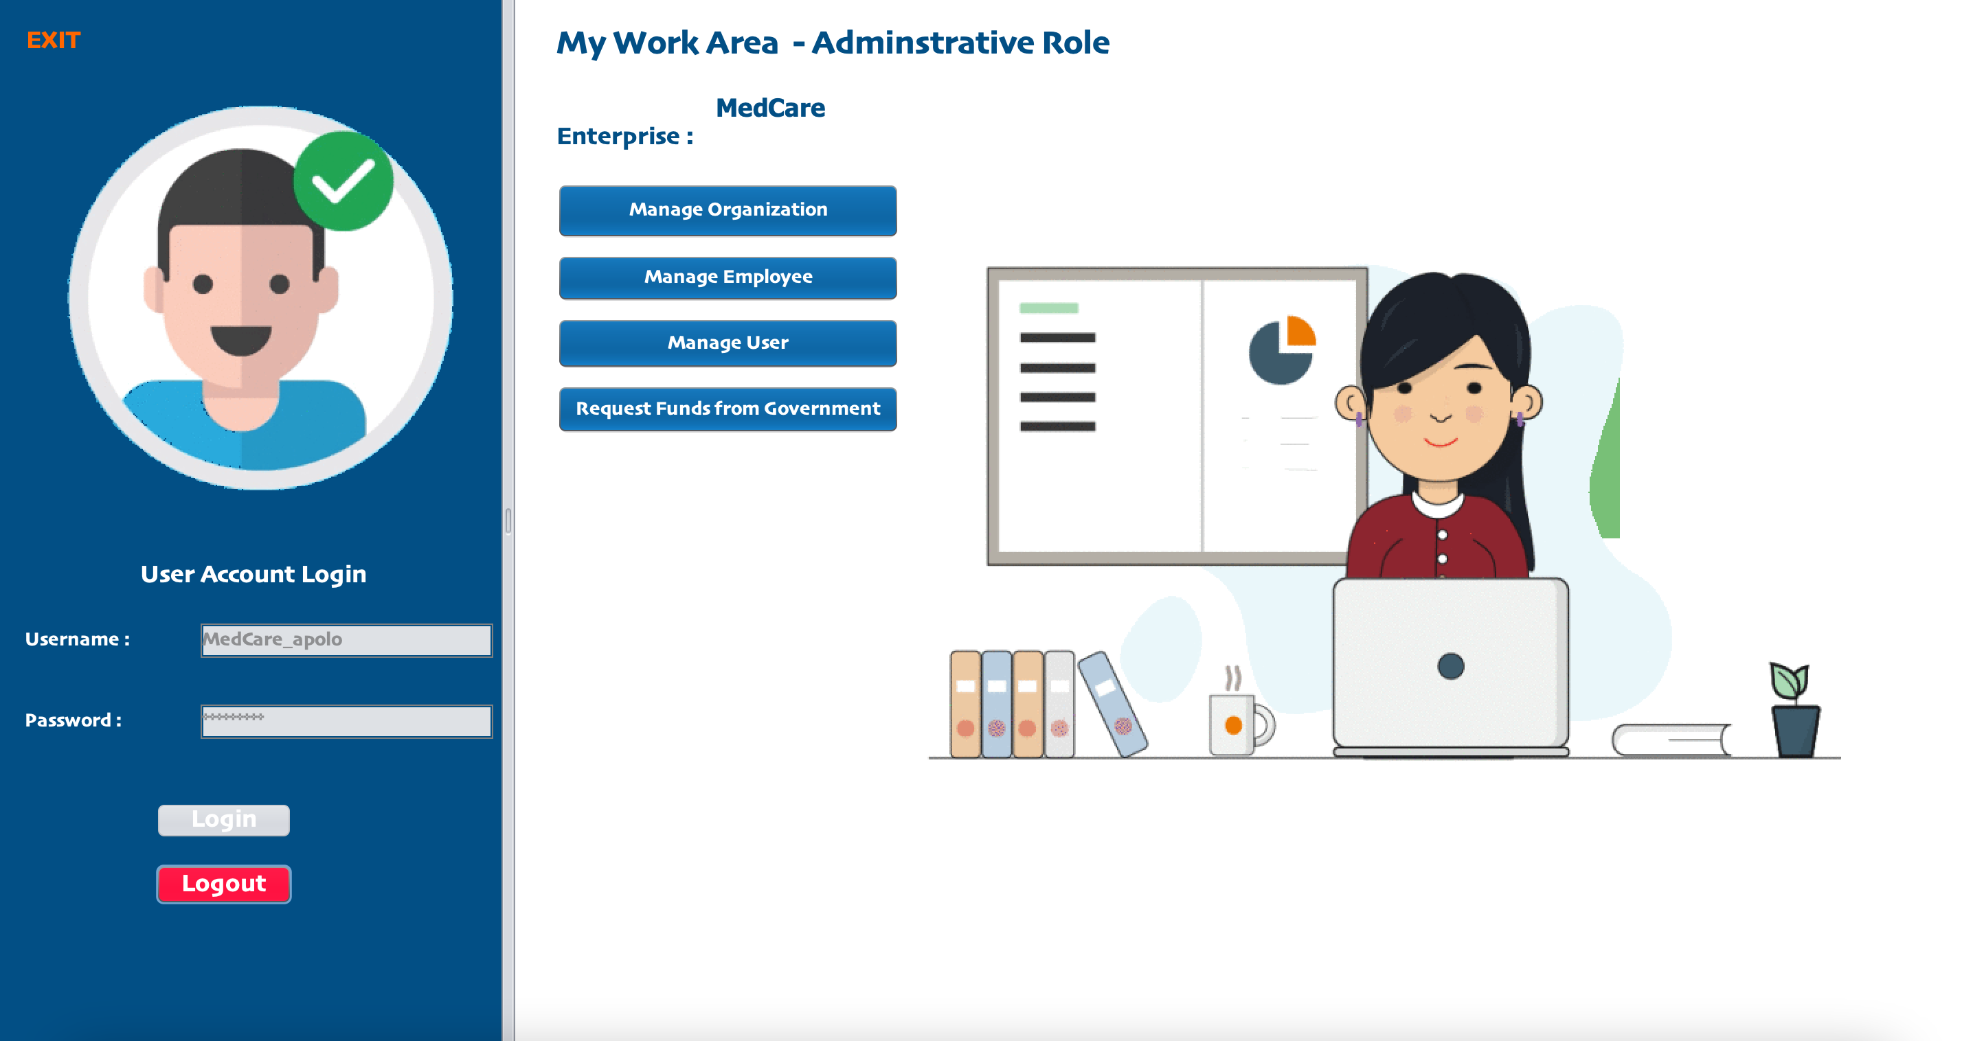

Slide 12

THANK YOU

